Slide 1


Elder Fraud in Alaska
Jesse L. Jones PMP, CISSP
Technical Project Manager, Include Security
President, InfraGard Alaska Members Alliance

Slide 2
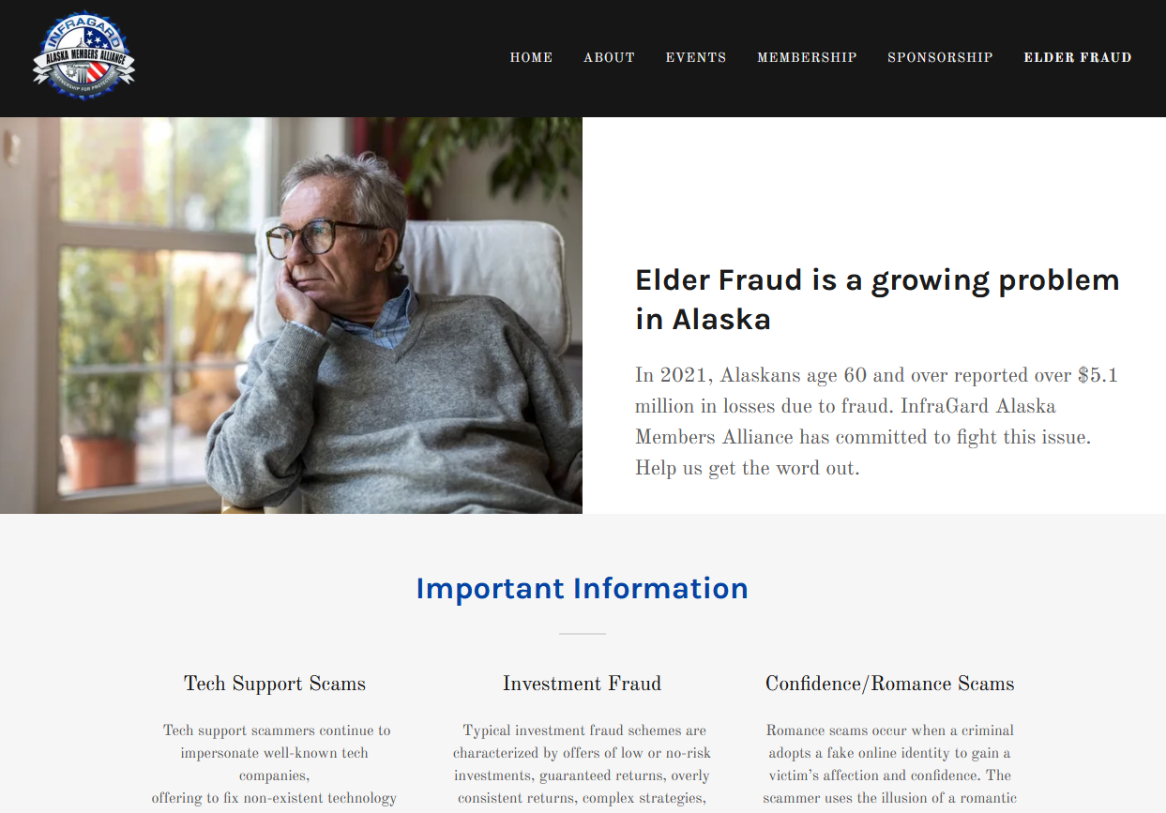
Elder Fraud Initiative
https://infragard-alaska.org/elder-fraud
Information page added to InfraGard Alaska Website
Scheduling speakers for community events/meetings
Community Outreach
Media
Partnerships

Slide 3
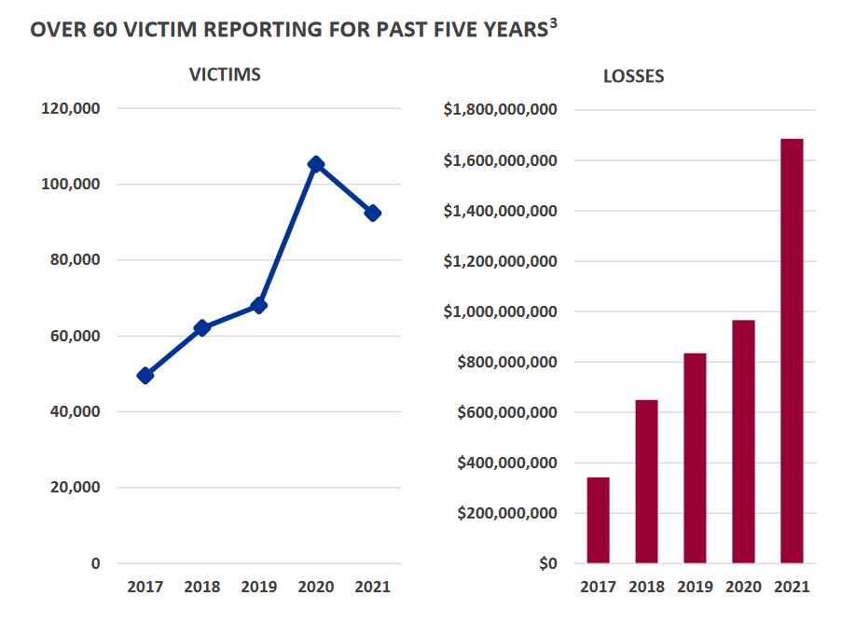
While the number of reporting victims decreased in 2021, the total losses increased.

Slide 4
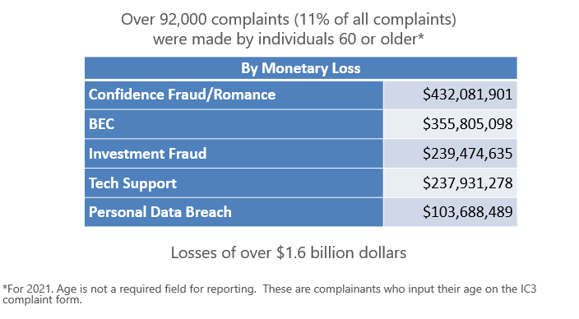

Slide 5
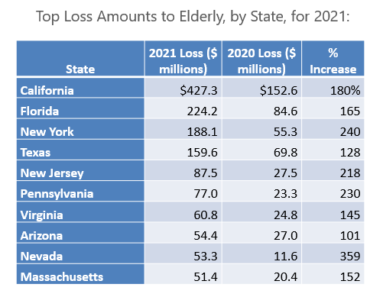

Slide 6
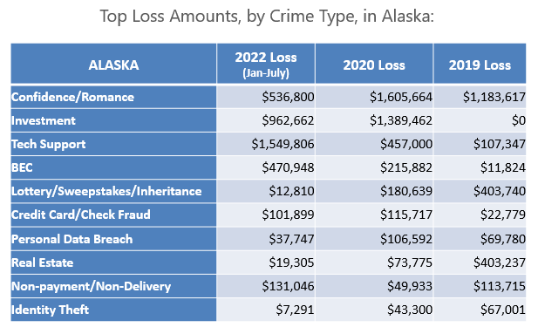
In 2021, Alaskans aged 60 and over reported over $5.1 million in losses due to fraud.
Notes:
Just over $3.8M in 1st half 2022
2021 - $5.1M
2020 - $4.2M
2019 - $2.4M

Slide 7
Tech Support Scams
Tech support scammers continue to impersonate well-known tech companies, offering to fix non-existent technology issues or renewing fraudulent software or security subscriptions.
Many victims report being directed to make wire transfers to overseas accounts, purchase large amounts of prepaid cards, or mail large amounts of cash via overnight or express services.
Tech Support Fraud is the most reported Fraud among Over 60 Victims. In 2021, the IC3 received 13,900 complaints related to Tech Support Fraud from elderly victims who experienced almost $238 million in losses.

Slide 8
Investment Fraud
Typical investment fraud schemes are characterized by offers of low or no-risk investments, guaranteed returns, overly consistent returns, complex strategies, or unregistered securities. Examples of investment fraud include advance fee fraud, Ponzi schemes, pyramid schemes, and market manipulation fraud.
These schemes often seek to victimize targeted individuals, such as groups with common interests, age, religion, or ethnicity, to build trust to effectively operate the investment fraud against them. The scammers’ ability to foster trust makes these schemes so successful.

Slide 9
Confidence Fraud / Romance
Romance scams occur when a criminal adopts a fake online identity to gain a victim’s affection and confidence. The scammer uses the illusion of a romantic or close relationship to manipulate and/or steal from the victim.
Grandparent Scams also fall into this category, where criminals impersonate a panicked loved one, usually a grandchild, nephew, or niece of an elderly person. The loved one claims to be in trouble and needs money immediately.
In 2021, the IC3 received reports from 7,658 victims who experienced over $432 million in losses to Confidence Fraud/Romance scams.

Slide 10
Business Email Compromise (BEC)
BEC is a scam targeting businesses (not individuals) working with foreign suppliers and/or businesses regularly performing wire transfer payments.
Email Account Compromise (EAC) is a similar scam which targets individuals.
These sophisticated scams are carried out by fraudsters compromising email accounts through social engineering or computer intrusion techniques to conduct unauthorized transfer of funds.

Slide 11
Typical Elder Abuse Victim
Between 70-89
White
Female
Frail
Cognitively Impaired

Slide 12
Why Target Seniors?
Nest Egg
  Retirees and Widows
Excellent Credit
Easy Targets
  Loneliness, dependence on others
Pose Less Risk to Criminals
  Less Likely to Report
Products/Service Offered by Con Artists Appeal to Seniors
Cognitive and Physical Impairments
  Dementia and Alzheimer's affect decision making and behaviors
  Eyesight, hearing, mobility decrease

Slide 13
How Can You Help?
Consider Information Sharing
Promote Awareness of Scams
Alert Family and Friends
Encourage Reporting
  www.ic3.gov
  1-800-CALL-FBI

Slide 14
Resources
https://infragard-alaska.org/elder-fraud
https://justice.gov/elderjustice
https://www.fbi.gov
https://www.ic3.gov

